Slide 1
Cross-sell project
SAS

Slide 2
OBJECTIVE
To find out which customers are more likely to buy the cross-sell product (permanent disability insurance with a low monthly premium.)
(A)
From Business point of view, to find a segment of customers who have highest propensity to buy cross-sell insurance product.
(B)
From Marketing point of view, to develop such strategies based on ideal customer profile to get a list of customers buying the insurance product .

Slide 3
WHAT IS CROSS-SELLING?
=> Cross-sell involves the sale of multiple products offered by a single product/service provider to a new or existing customer.
=> For example:- Suppose a customer plans to purchase a Laptop worth Rs. 35,000 , but the salesman offered him a charming deal of buying Laptop with exclusive EPSON printer for Rs.39,999 only and he again got swayed away. This is Cross-Selling (figure 1.)

Slide 4
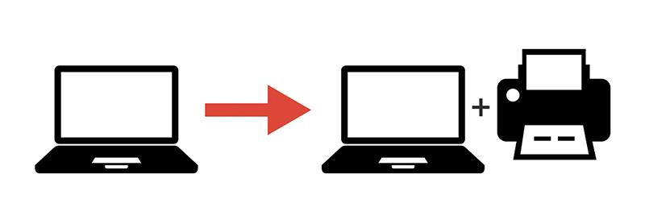
FIGURE 1: EXAMPLE OF CROSS-SELLING

Slide 5
BUILDING THE LOGISTIC REGRESSION MODEL ON THE CROSS-SELL DATASET

Slide 6
ABOUT THE DATA
=> There are 32264 number of observations with 48 variables in the given dataset.
=>'INS'- Insurance Product is the Dependent variable and that is Binary in nature.
=> The descriptions of all the variables is given below:
DATA TYPE | NUMBER OF VARIABLES
BINARY | 18
CONTINUOUS | 28
CATEGORICAL | 2

Slide 7
IV-VALUE AND WOE (WEIGHT OF EVIDENCE)
S.NO. | SELECTED VARIABLE WITH IV –VALUE BETWEEN (0.1-0.5)
1 | DDABAL
2 | SAVBAL
3 | ATMAmt
4 | CDBAL
5 | AGE
6 | DEP
7 | DEPAmt
8 | PHONE
9 | MMBAL

Slide 8
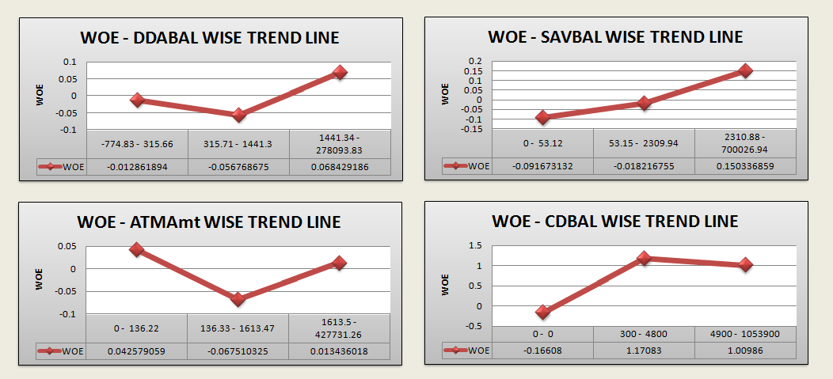
WOE DIAGRAMS OF SIGNIFICANT VARIABELS

Slide 9
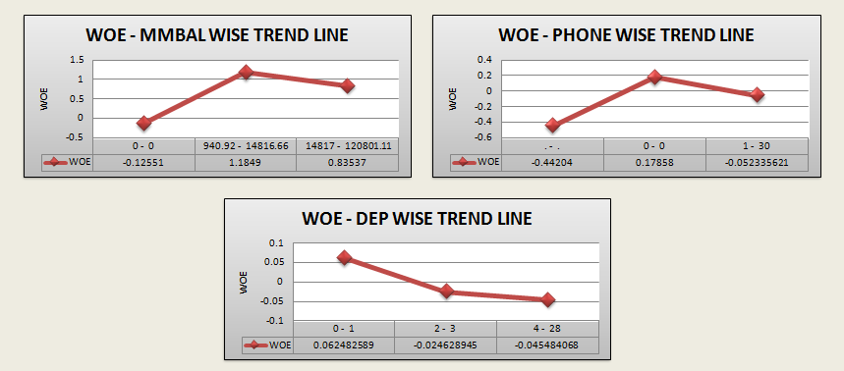
PART 2

Slide 10
PRE-MODELLING INSIGHTS BASED ON WOE - DIAGRAMS
=> Customers who have checking balance between 1441.34-278093.83 are most likely to buy Insurance products.
=> Customers who have saving balance between 2310.88 - 700026.94 are most likely to buy Insurance products.
=> Customers whose ATM withdrawal amount lies between 1613.5 - 427731.26 are most likely to buy Insurance products.
=> Customers who have CD(certificate of Deposit) balance between 4900 - 1053900 are most likely to buy Insurance products.

Slide 11
=> Customers who have MM(Money Market) balance between 14817 - 120801.11 are most likely to buy Insurance products.
=> Customers who have Checking deposits 0 & 1 are most likely to buy Insurance products.
=>Customers who have ZERO as Telephone number for Banking are most likely to buy Insurance products.

Slide 12
The model is built on the development sample(70%) and further validated on ‘validation’ sample (30%) which concludes 10 significant variables at 99% and 95% CI after clearing all statistical tests.

Slide 13
SIGNIFICANT VARIABLES
S.NO. | SIGNIFICANT VARIABLE | DESCRIPTION
1 | DDABAL | CHECKING BALANCE
2 | SAVBAL | SAVING BALANCE
3 | MMBAL | MONEY MARKET BALANCE
4 | CDBAL | CD BALANCE
5 | PHONE | TELEPHONE NUMBER FOR BANKING
6 | ATMAmt | ATM WITHDRAWAL AMOUNT
7 | DEP | CHECKING DEPOSITS
8 | DIRDEP | DIRECT DEPOSITS
9 | IRA | RETIREMENT ACCOUNT
10 | INAREA | LOCAL ADDREES

Slide 14
INTERPRETATIONS
SELECTED VARIABLE | SIGN OF EFFECT | ESTIMATE | INTERPRETATION
DDABAL_WOE | +VE | 5.9484 | => If the customer increases his Checking balance by one unit, he is 5.9 times more likely to buy insurance product.
SAVBAL_WOE | +VE | 6.6345 | => If the customer increases his Saving balance by one unit , he is 6.63 more times likely to buy the insurance product.

Slide 15
CDBal_WOE | +VE | 0.7479 | => If the customer increases his certified Deposit balance by one unit, he is 0.74 more times likely to buy the insurance product.
MMBal_WOE | +VE | 0.9356 | => If the customer increases his Money Market balance by one unit, he is 0.93 more times likely to buy the insurance product.
DEP_WOE | +VE | 2.2344 | => If the customer increases his deposit balance by one unit, he is 2.23 more times likely to buy the insurance product.
PHONE_WOE | +VE | 1.0835 | => If the customer changes telephone number for banking, he is 1.08 more times likely to buy the insurance product.

Slide 16
DIRDEP | -VE | -0.2354 | => If the customer adopts the service of Direct Deposit, he is 0.23 times less likely to buy the insurance product and vice versa.
IRA | +VE | 0.4928 | => If the customer has Retirement Account, he is 0.49 more times likely to buy the insurance product.
INAREA | -VE | -0.2882 | => If the customer has given Local address, he is 0.28 times less likely to buy the insurance product and vice versa.
ATMAmt | +VE | 2.9407 | => If the customer increases his ATM withdrawal amount by one unit, he is 2.94 more times likely to buy the insurance product.

Slide 17
BUSINESS INSIGHTS
=> To develop market strategies targeting the customers who have higher:
* ATM Withdrawal amount.
* Money Market Balance.
* Saving Balance.
* Checking Balance.
=> Customers with 'Retirement Accounts' can also be targeted.
=> Strategies should be appealing to a customer in order to adopt services like Direct Deposits and Telephone number for Banking.

Slide 18
=> Services like Internet or Phone Banking can also be proved beneficial for buying Insurance products.
=> Relevant and discounted suggested products can be appealing for buying to a customer.
=> Customers with Certified Deposit Balance can be targeted for secured payments and purchases.
=> Cross -sell products should be chosen/suggested for a segment of customers as per their history of purchases.

Slide 19
=> Cross-Selling can be targeted to the customers who use ATM cards and have active and secured transactional logs.
=> Cross-sell Products should be available within the given local address of a customer in order to make his experience more better and satisfactory.
=> E-commerce could be helpful to reaching out to the targeted customers with more relevant products at affordable prices.

Slide 20
=> Great deals and offers can drive customers to buy Insurance products.
=> Business Strategy in to order to increase the revenue is possible by providing various Payment Modes such as:
* E-wallets.
* Cash on Delivery.
* Debit Card/ Credit Card.
=> Also, strategies about increasing limit of credit card for frequent buyers may also increase propensity to buy cross – sell products.

Slide 21
THANK YOU..!! ☺

